Slide 1
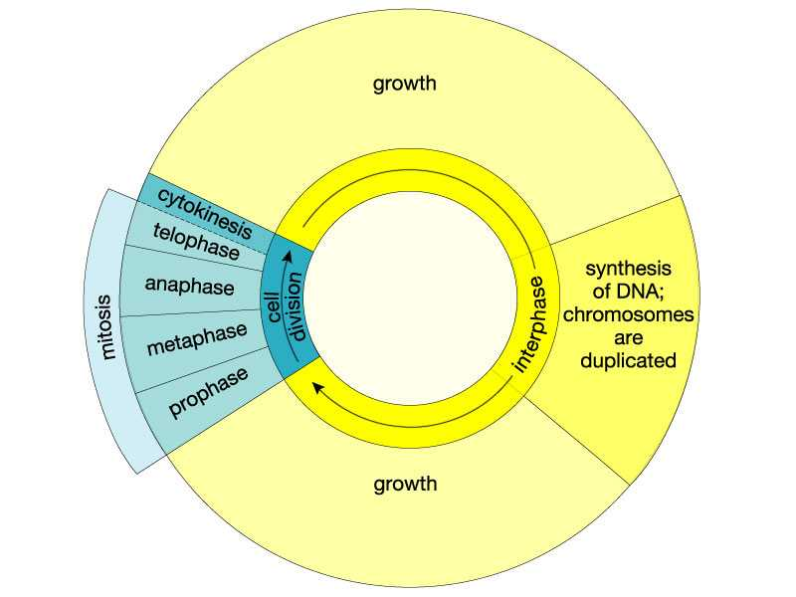

Slide 2
The Cell Cycle and Mitosis
The cell cycle is a sequence of growth and division in a cell.
It has 2 distinct periods: Interphase and Mitosis.
  Period of growth is called Interphase.
    A cell increases in size.
    Chromosomes are copied to get ready for division.
    New organelles are synthesized for the new cell.

Slide 3
2. Period of Division is called Mitosis (Division of Nucleus)
2 daughter cells are formed with identical copies of chromosomes.
Period of Cellular Division called Cytokinesis.

Slide 4
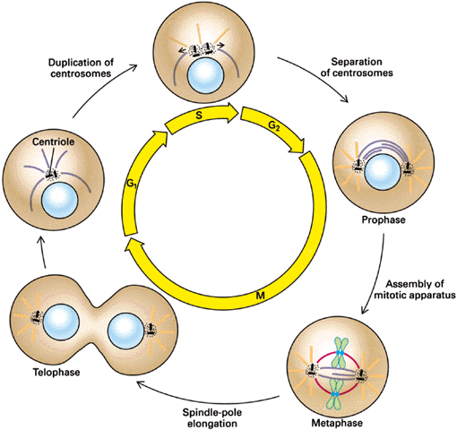
Cell Division (Mitosis)

Slide 5
Definitions
Chromatin – Uncoiled DNA
Chromosomes – Coiled DNA
Chromatid – ½ of a chromosome
Centromere – Connects two chromatids together to make a chromosome
Centrioles – Organelles used in cell division to move chromosomes to opposite side of the cell.
Mitosis - is normal cell division (makes body cells)
Meiosis - is the special cell division that creates the sperm and eggs
Daughter Cell(s) – the new cells produced by Mitosis.

Slide 6
Cell Growth and Death
Growth
  Mitosis: growth and development
  Meiosis: reproductive cells
Death
  Apoptosis: programmed cell death

Slide 7
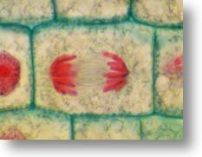
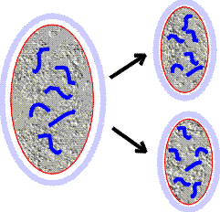
Mitosis
Cells divide to make more cells.
Chromosomes must be precisely divided so that each daughter cell gets exactly the same DNA.
Mitosis is normal cell division, which goes on throughout life in all parts of the body.
Meiosis is the special cell division that creates the sperm and eggs, the gametes. We will discuss meiosis separately.

Slide 8
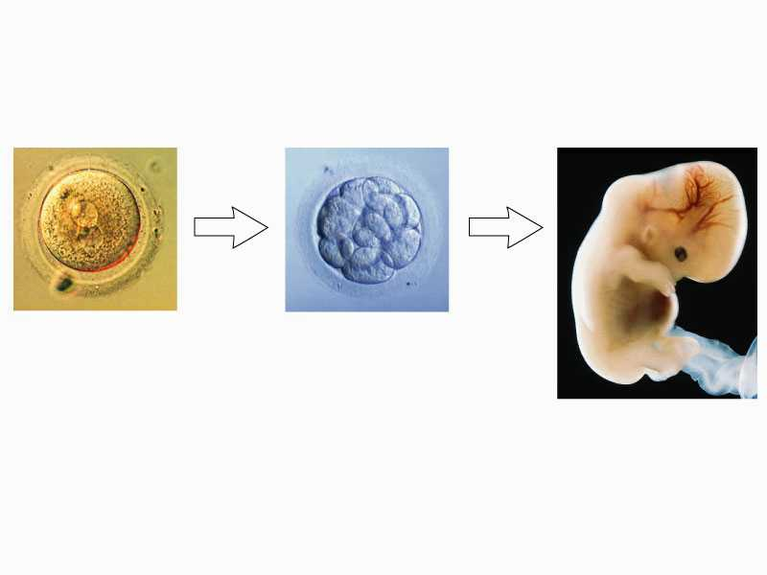
Mitosis: development
mitotic
cell
division
mitotic
cell
division
(a)
(b)
(c)

Slide 9
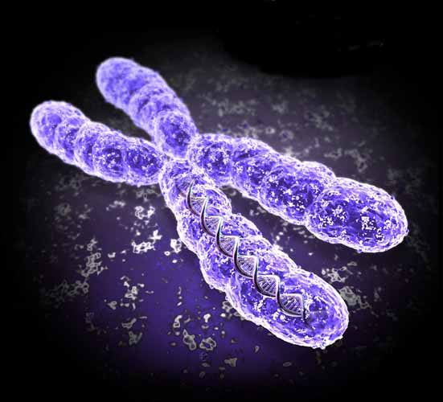
Chromosomes
The DNA is supported and neatly packaged. DNA in the nucleus is uncoiled (chromatin), or tightly condensed into the X-shaped chromosomes we can see in the microscope.
Each chromosome has a central constricted region called a centromere that serves as an attachment point for the machinery of mitosis.
Centromere

Slide 10
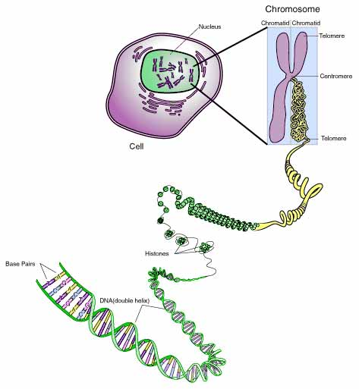

Slide 11
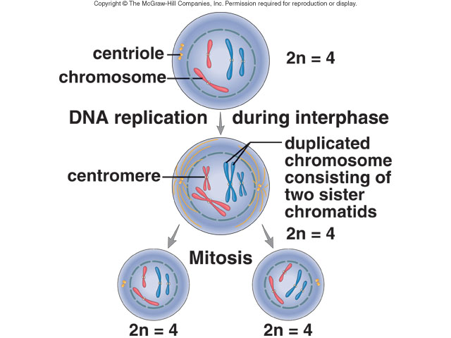
Mitosis Overview

Slide 12
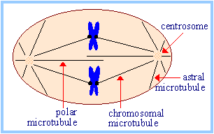
Machinery of Mitosis
The chromosomes are pulled apart by the spindle fibers, which is made of microtubules.
The spindle fibers are attached to each centromere , and anchored on the other end to a centriole (which is the organizing center for the spindle).

Slide 13
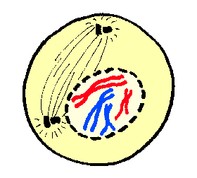
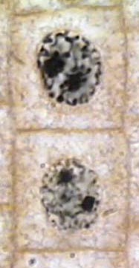
Prophase
1. The chromatin condense making chromosomes, which makes them easier to pull apart.
2. The nuclear envelope and nucleolus disappears.
3. The centrioles move to opposite poles.
4. The microtubules form spindle fibers, growing out of the centrioles towards the chromosomes.

Slide 14
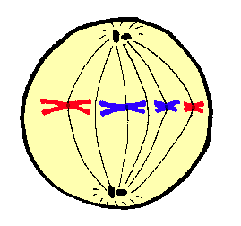
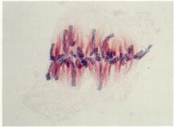
Metaphase
Metaphase is a short resting period where the chromosomes are lined up on the equator of the cell, with the centrioles at opposite ends and the spindle fibers attached to the centromeres. Everything is aligned for the rest of the division process to occur.

Slide 15
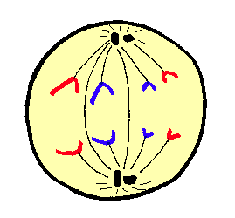
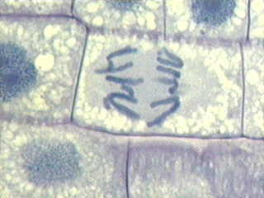
Anaphase
In anaphase, the centromeres divide.
Spindle fibers are attached to the centromeres
Then the spindle fibers contract, and the chromosomes are pulled to opposite poles, towards the centrioles.

Slide 16
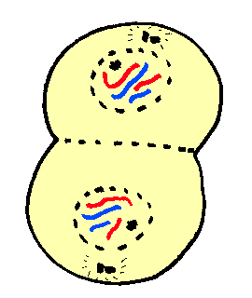
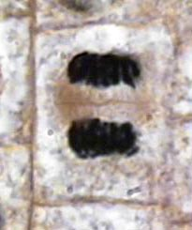
Telophase
In telophase the cell begins to divide.
The chromosomes are at the poles.
The spindle fibers disintegrates,The nuclear envelope and nucleolus re-forms
The cytoplasm is divided into 2 separate cells, the process of cytokinesis.

Slide 17
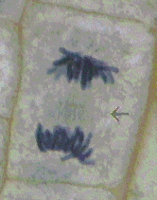
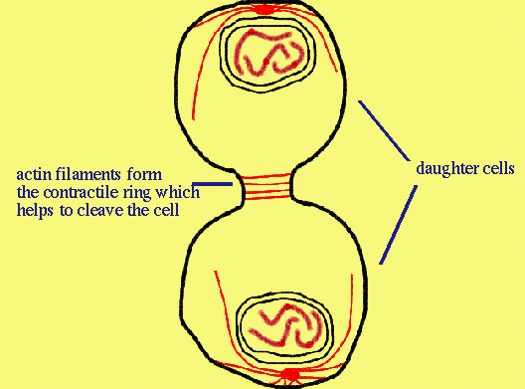
Cytokinesis
The organelles (other than the chromosomes) get divided up into the 2 daughter cells passively: they go with whichever cell they find themselves in.
In animal cells, a ring of actin fibers (microfilaments are composed of actin) forms around the cell equator and contacts, pinching the cell in half.

Slide 18
Summary of Mitosis
Prophase:
    Chromatin condenses into chromosomes
    Nuclear envelope and nucleolus disappears
    centrioles move to opposite sides of the cell
    Spindle fibers form and attaches to centromeres on the chromosomes
Metaphase
    Chromosomes lined up on equator of cell
    centrioles at opposite ends of cell
Anaphase
    Centromeres divide: each chromosome becomes two chromatids
    Chromosomes pulled to opposite poles by the spindle fibers
Telophase
    Chromosomes de-condense
    Nuclear envelope and nucleolus reappears
    Spindle fibers disappear
    Cytokinesis: the cytoplasm is divided into 2 cells

Slide 19
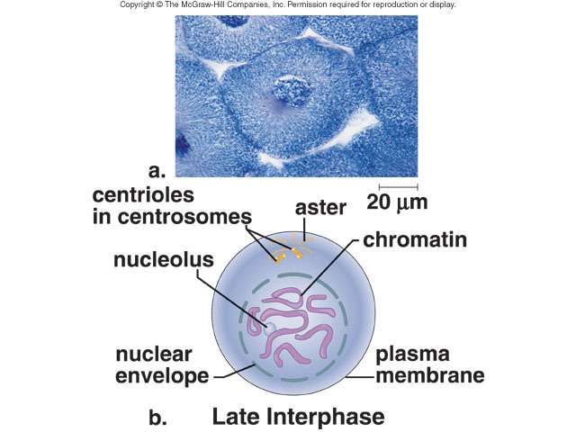
Late Interphase

Slide 20
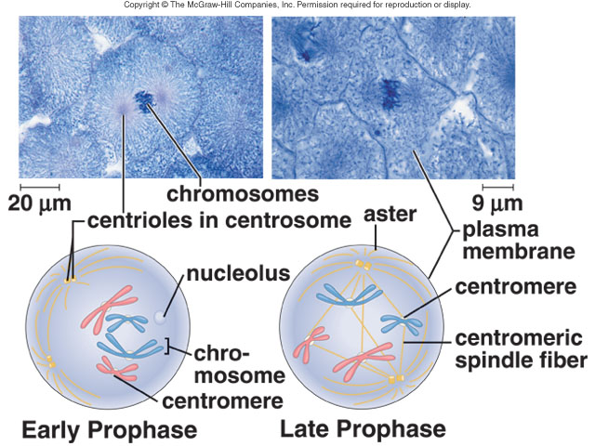
Prophase

Slide 21
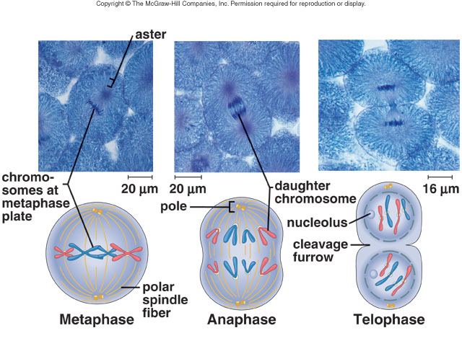
Meta- Ana- and Telo-phase

Slide 22
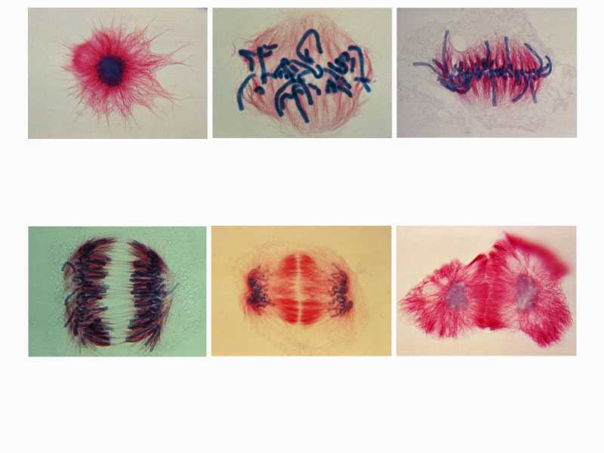
(a) Interphase
(b) Late prophase
(c) Metaphase
(d) Anaphase
(e) Telophase
(f) interphase

Slide 23
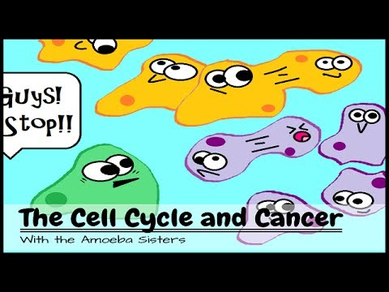
Control of the Cell Cycle -
Normal Control of the Cell Cycle
  Controlled by enzymes and proteins which are controlled by the environment.
  Uncontrolled division can result in cancer.

Slide 24
Cancer: A mistake in the Cell Cycle
Results of mistakes in one or more genes that produce substances involved in controlling the enzymes of the cell cycle (cyclins).
This can lead to the formation of masses of cells (tumors)
  Can enter the circulatory system and spread throughout the body (metastasis).
  2nd leading cause of death in U.S. after heart disease.

Slide 25
Causes of Cancer
Genetic – passed on from parent to offspring.
Environmental – different cancers are more prevalent in different areas.
  Cigarette smoke, air/water pollution, UV radiation, and chemicals are called carcinogens or mutagens.

Slide 26
Cancer Prevention
Diets low in fats and high in fiber can reduce the risks of many kinds of cancer.
Why?
Vaccines and sunscreen may also help prevent cancer.
Daily exercise and not using alcohol, drugs, or cigarettes also reduce the risk of cancer.

